Slide 1

Gaining Competitive Advantages
in Fantasy Basketball
Jackson Au

Slide 2

Fantasy basketball is popular!
Fantasy sports is very popular due to its competitive nature and financial implications. Over the years, the community has only grown larger!
US-only, 18+ year old fantasy sports players
Year | Estimated Number of Players
2015 | 42 million
2016 | 42.8 million
2017 | 43.2 million
2019 | 45.9 million

Slide 3
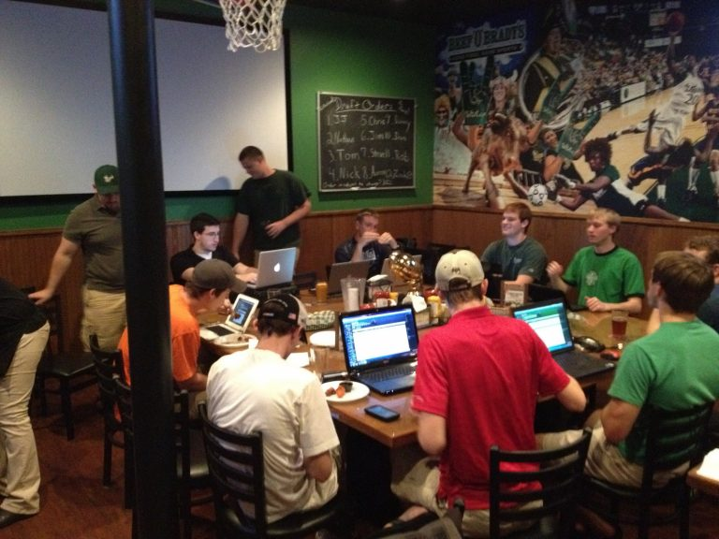
PROBLEM STATEMENT
With the growing number of experienced players in fantasy basketball, gaining any slight advantage can help you win!
Using historical data, what competitive advantages can we gain?

Slide 4


Data utilized
BasketballMonster Rankings (2015–2019)
Historical NBA standings (2015-2019)
Personal league data (2015-2019)

Slide 5
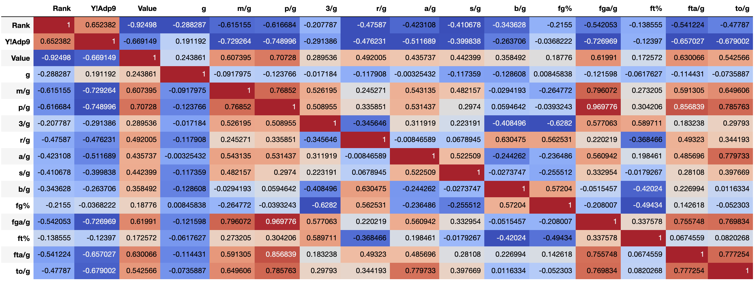

Exploratory Data Analysis
Player Name | Frequency
Josh Richardson
Kemba Walker
Marc Gasol
Elfrid Payton Goran Dragic Khris Middleton Kyle Lowry Pau Gasol
Common players on winning teams
Correlation Matrix – All variables

Slide 6
Exploratory Data Analysis - Takeaways
Player Name | Frequency
Josh Richardson
Kemba Walker
Marc Gasol
Elfrid Payton Goran Dragic Khris Middleton Kyle Lowry Pau Gasol
Player Name | Avg cost (across 4 years)
Josh Richardson | 12
Kemba Walker | 29
Marc Gasol | 25.8
Elfrid Payton | 6
Goran Dragic | 15.3
Khris Middleton | 15.5
Kyle Lowry | 32.5
Pau Gasol | 14.3
Common players on winning teams (out of 8 rosters)
None of these players are “superstars” and are inexpensive to draft: 6 – 32 dollar range

Slide 7
Exploratory Data Analysis - Takeaways
ADP and Value seems highly correlated with RANK (our target),
so we may want to avoid using those when modeling.

Slide 8
Can we utilize data to help us draft higher-ranked players, consistently?

Slide 9
Model [baseline]
Our baseline model was a Logistic Regression implementation with some validation techniques:
MODEL | ACCURACY
Linear Regression w/ train-test split | 50.0%
Linear Regression w/ k-fold | 40.23%
Our baseline model is below average

Slide 10
Model [improved!]
In this model, I find additional data that can help our predictability. As shown below, our accuracy for prediction goes up!
MODEL | ACCURACY
Random Forest w/ train-test split | 64.25%

Slide 11
Best Model [model tuning + feature engineering]
After finding model tuning and feature engineering, I created a much better model than our baseline
MODEL | ACCURACY
Random Forest with feature engineering + model tuning | 82.06%
With model tuning and feature engineering, I can make better use of my data.

Slide 12
Model Comparison
MODEL | ACCURACY
Linear Regression (Baseline) | 50%
Random Forest (more data) | 64.25%
Random Forest (model tuning) | 82.06%

Slide 13
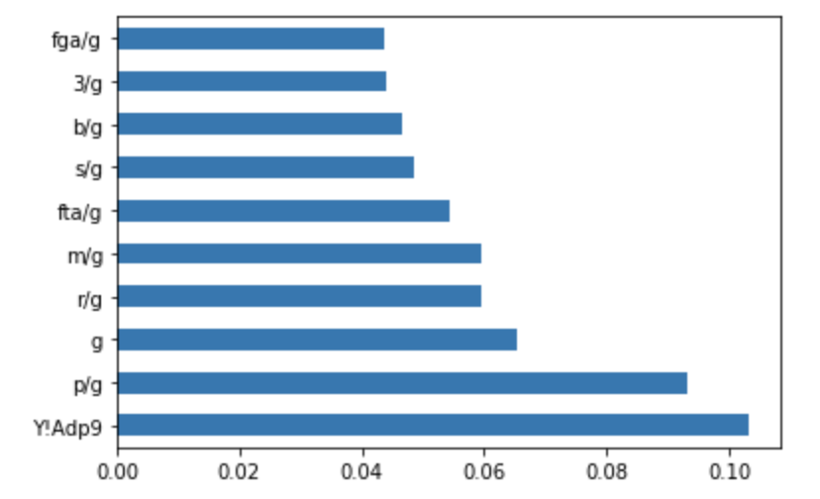
Diving Deep into our model
Using Recursive Feature Elimination, we determine which attributes
were most important in our final model:

Slide 14
FINAL CONCLUSIONS
Auction Drafts
Going for a stars-and-scrubs approach will have less room for error. Aim for players in the $6-30 range.
Important Features
Assists did not land in the top-10 most important features. Value can be found outside of this often overhyped category.
Let’s sum up the matter with some final conclusions about the presentation.
Potential breakouts
Look for players that may be given the opportunity to play more. Minutes Per Game were a key indicator of a high ranked player.
NBA parity
In the past, it was easy to avoid resting players. However, with the NBA approaching parity, there is evidence of high-ranked players on playoff teams.

Slide 15

Thank you!

